Slide 2
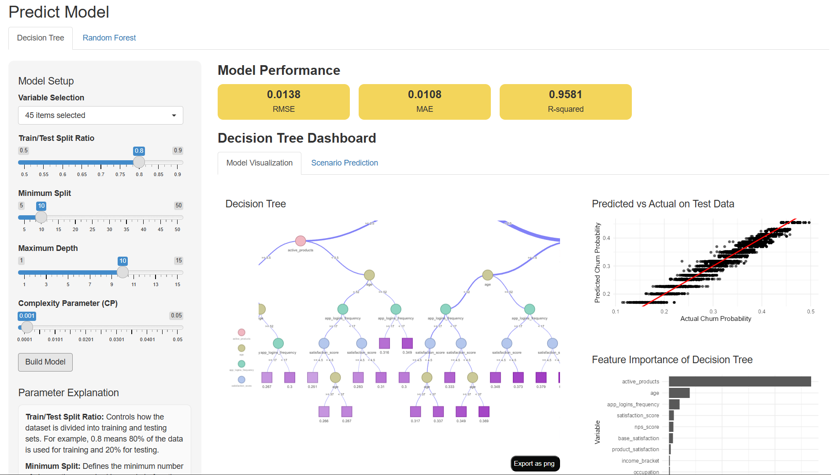

Slide 3
Variable Selection
Multiple variables allowed. Displays names if <10 selected; otherwise, shows count only. Includes "Select All" and "Deselect All”.
Train/ Test Split Ratio
Set train/test split ratio. (Default: 80% training, 20% testing.)
Minimum Split
Set the minimum observations for a node split. Higher values simplify the tree; lower values allow more detail. (Default: 10)
Maximum Depth
Set the maximum depth of the tree. Higher values create a deeper, more complex tree; lower values keep the model simpler and easier to interpret. (Default: 10)
Complexity Parameter (CP)
Complexity Parameter (CP)Set the minimum improvement required for an additional split. Higher values produce a simpler tree, while lower values allow more splits. (Default: 0.001)
Build Model
Click to train the decision tree using the selected variables and parameter settings. The dashboard will update with model performance and visualizations.
Parameter Explanation
Provide more intuitive text explanations for users on the concepts of Train/Test Split Ratio, Minimum Split, Maximum Depth, and Complexity Parameter (CP).

Slide 4
Model Performance
Click “Build Model” to automatically calculate RMSE, MAE, and R-squared for model evaluation.
RMSE
Measures the overall prediction error, giving more weight to larger errors. Lower values indicate better model performance.
MAE
Measures the average absolute difference between predicted and actual values. Lower values indicate more accurate predictions.
R-squared
Shows how well the model explains the variation in the target variable. Values closer to 1 indicate a better fit.

Slide 5
Model Visualization
Displays the trained decision tree, prediction accuracy on test data, and the relative importance of model features.
Predicted vs Actual on Test Data
Compares predicted churn probability with actual churn probability on the test dataset. Points closer to the red diagonal line indicate better prediction accuracy.
Decision Tree
Displays the structure of the trained decision tree. Each split shows how the model segments the data based on predictor values, ending in terminal nodes that generate the final prediction. Users can zoom in or out to inspect the tree in more detail.
Feature Importance of Decision Tree
Shows the top 10 most important variables used in the decision tree. Higher values indicate that a variable contributes more to the model’s predictions.

Slide 6
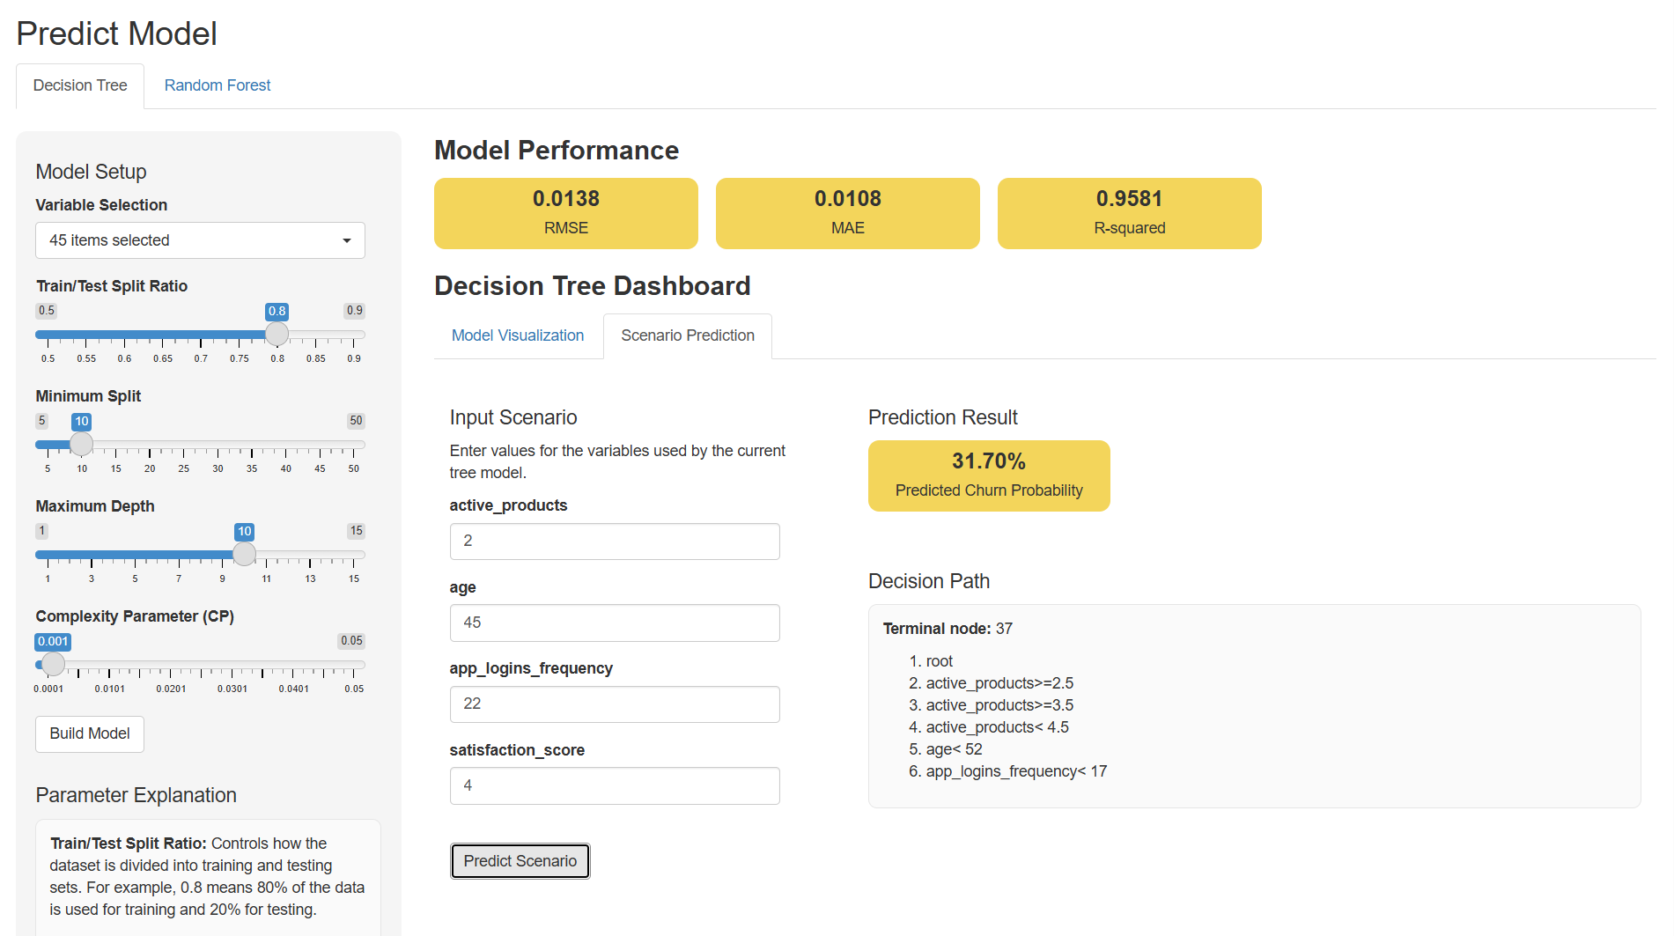
Scenario Prediction
Allows users to input values for the selected variables, generate a predicted churn probability, and view the corresponding decision path.
Prediction Result
Displays the predicted churn probability for the selected input scenario.
Input Scenario
Enter values for the variables used in the current tree model.
Decision Path
Shows the terminal node and the sequence of split conditions used to reach the prediction.
Predict Scenario
Click to generate the predicted churn probability for the entered input values and display the corresponding decision path.

Slide 7
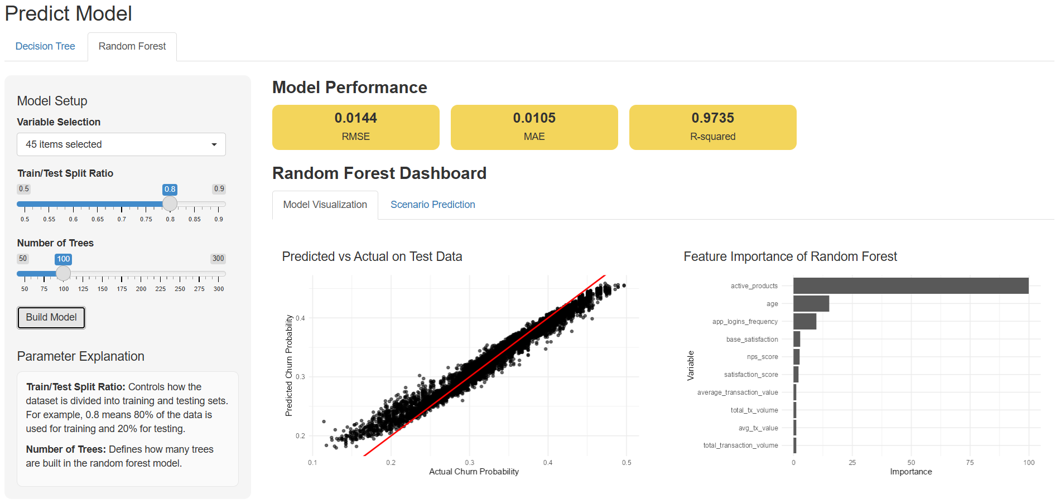
Variable Selection
Multiple variables allowed. Displays names if <10 selected; otherwise, shows count only. Includes "Select All" and "Deselect All”.
Train/ Test Split Ratio
Set train/test split ratio. (Default: 80% training, 20% testing.)
Number of Trees
Specifies the total number of decision trees to be built in the forest. A higher number typically increases model stability and accuracy but requires more computational time. (Default: 100)
Build Model
Click to train the random forest using the selected variables and parameter settings. The dashboard will update with model performance and visualizations.
Parameter Explanation
Provide more intuitive text explanations for users on the concepts of Train/Test Split Ratio, Number of Trees.

Slide 8

Model Performance
Click “Build Model” to automatically calculate RMSE, MAE, and R-squared for model evaluation.
RMSE
Measures the overall prediction error, giving more weight to larger errors. Lower values indicate better model performance.
MAE
Measures the average absolute difference between predicted and actual values. Lower values indicate more accurate predictions.
R-squared
Shows how well the model explains the variation in the target variable. Values closer to 1 indicate a better fit.

Slide 9
Model Visualization
Displays the trained random forest, prediction accuracy on test data, and the relative importance of model features.
Predicted vs Actual on Test Data
Compares predicted churn probability with actual churn probability on the test dataset. Points closer to the red diagonal line indicate better prediction accuracy.
Feature Importance of Decision Tree
Shows the top 10 most important variables used in the random forest. Higher values indicate that a variable contributes more to the model’s predictions.

Slide 10
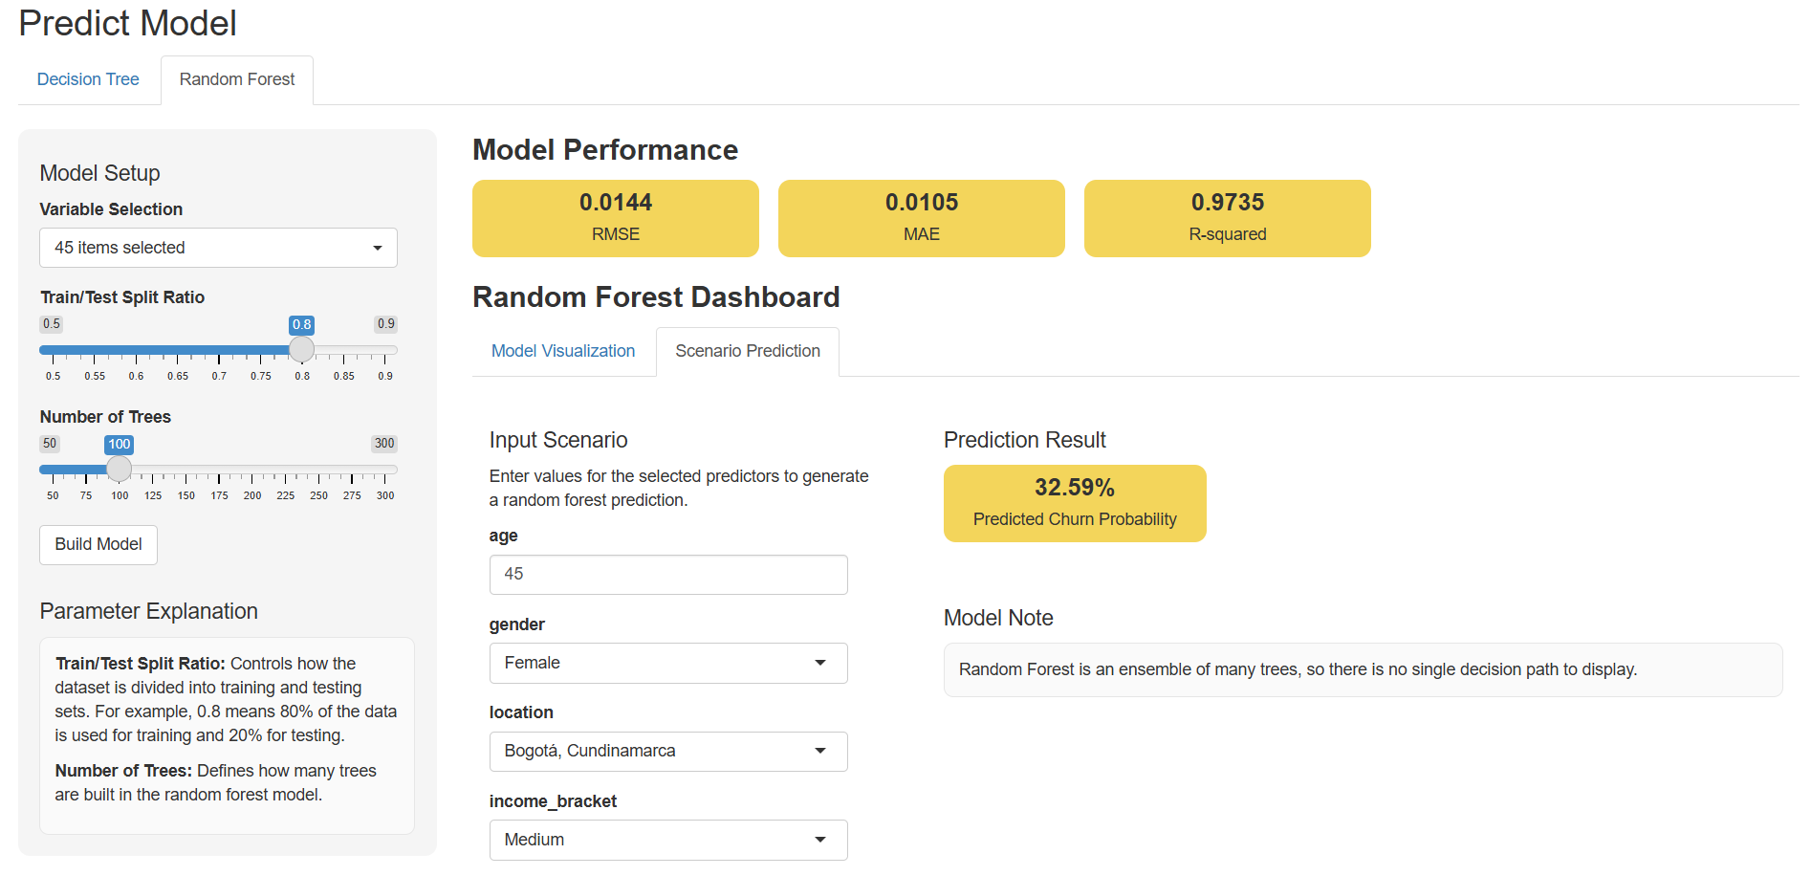
Scenario Prediction
Allows users to input values for the selected variables, generate a predicted churn probability.
Prediction Result
Displays the predicted churn probability for the selected input scenario.
Input Scenario
Enter values for the variables used in the current model.

